Slide 1
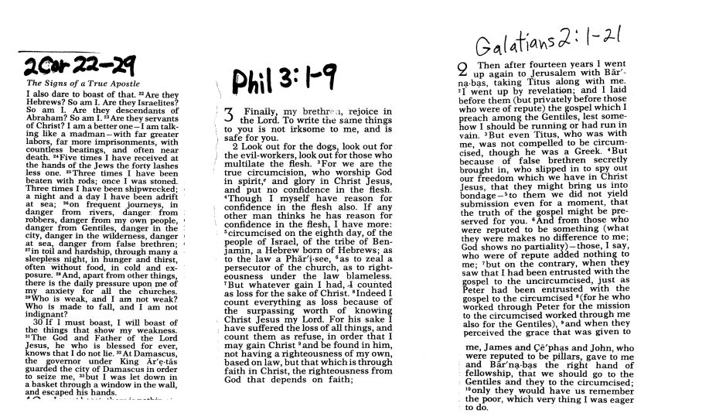
The Life of Paul in His Own Words

Slide 2
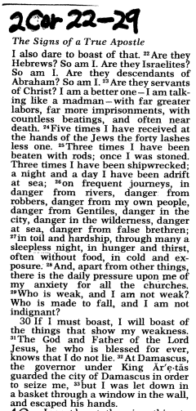
2 Corinthians 11:22-29

Slide 3
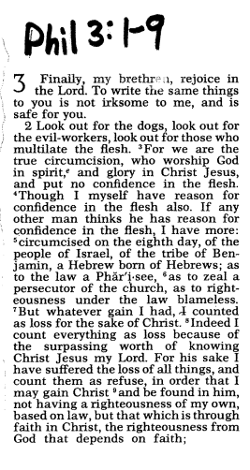
Philippians 3:1-9

Slide 4
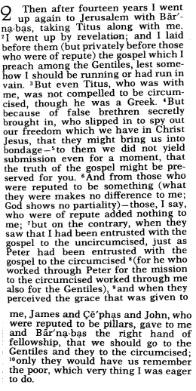
Galatians 2:1-21

Slide 5
ST. PAUL: THE MAN AND HIS WRITINGS
REV. ANDREW J. UMBERG, MA, STL
ST. IGNATIUS CHURCH
LENT, 2026
FIRST LECTURE: Saul: the Jew from Tarsus
Abraham, Isaac and Jacob (aka “Israel”)
12 sons of Israel (the 12 tribes, more or less)
Promised Land (Canaan)
Egypt, Mesopotamia, Empires
Slavery—400 years
Exodus, Moses, Sinai Covenant (Torah—“Law”) God’s own people
Conquest of Promised Land, Judges, Samuel
A Request for a King.
King Saul, from tribe of Benjamin (displeased God)
King David, from tribe of Judah (pleased God)
David captures Jerusalem and Zion fortress
Promise to King David: a dynasty that lasts forever
King Solomon, son of David: Built Temple of the Lord
But Solomon displeased God, Kingdom to Split
(Southern Kindgom: “Judah”) Northern Kingdom (“Israel”)
Northern Kingdom destroyed by Assyrian Empire 721 BC

Slide 6
ST. PAUL: THE MAN AND HIS WRITINGS CONT….
Southern Kingdom sacked and taken to exile by Babylonian Empire 587 BC
Persian Empire takes Babylon, frees Israel to go back and build temple and Jerusalem
Second Temple built---Northern Kingdom remnants not welcome
Southern Kingdom, not really a kingdom, but it is Judah—Judaism!
Diaspora-the Jews are scattered throughout the world and communities grow there
Messianic hope: an anointed king of the house of David will unite the Jews, rule the world
Greek Empire conquers world—Philip of Macedon, then son, Alexander the Great 333BC
Roman Conquers world, occupies holy land: PROVINCE OF JUDEA
Jesus born, preaches, dies, rises. Commissions apostles, beginning in Jerusalem
Acts 7:58- 8:1
Acts (9:1-31)
Acts 13:12-25
Acts 11:27-30
Acts 11:19-26
Acts 12:12 & 12:25

Slide 7
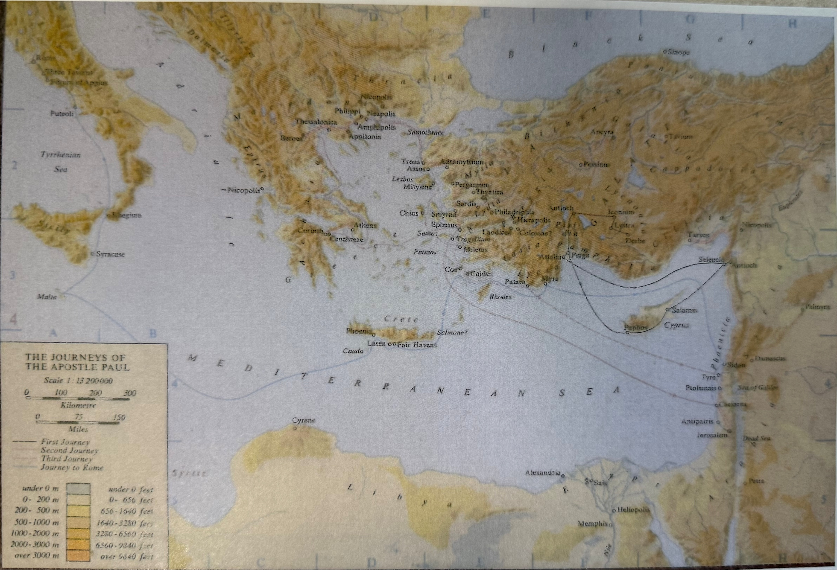

Slide 8
